Slide 1
Expectations Theory and the Economy

Slide 2
Phillips Curve Analysis
The Phillips curve suggests that the rate of change of money wage rates (wage inflation) and unemployment are inversely related.
This suggests a tradeoff between wage inflation and unemployment. Higher wage inflation means lower unemployment.
It is impossible to lower both wage inflation and unemployment: It was possible to do one or the other.
The good news is that high unemployment and high wage inflation do not go together.

Slide 3
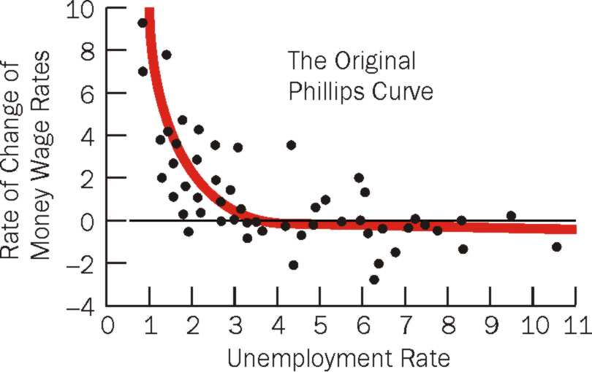

Slide 4
Theoretical Explanations for the Phillips Curve
Early explanations focused on the state of the labor market given changes in aggregate demand.
Businesses must offer higher wages to obtain additional workers.
  Efficiency Wage

Slide 5
Americanizing the Phillips Curve
Economists concluded that stagflation, or high inflation together with high unemployment was extremely unlikely.

Slide 6
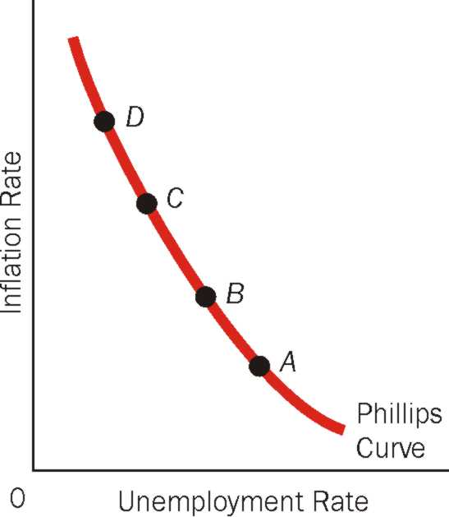
The Phillips Curve & a Menu of Choices
Samuelson and Solow’s early work using American data showed that the Phillips curve was downward sloping. Economists reasoned that stagflation was extremely unlikely and that the Phillips curve presented policy makers with a menu of choices: Point A, B, C, or D.

Slide 7
Deriving the Phillips Curve From the Aggregate Supply Curve
The Phillips curve in its modern form states that the inflation rate
depends on three forces:
1) Expected inflation
2) The deviation of unemployment from the natural rate, called
cyclical unemployment
3) Supply shocks
These three forces are expressed in the following equation:
π = π^{e} − β(u-u^{n}) + ν
Inflation
Expected
inflation
β × Cyclical
unemployment
Supply shocks

Slide 8
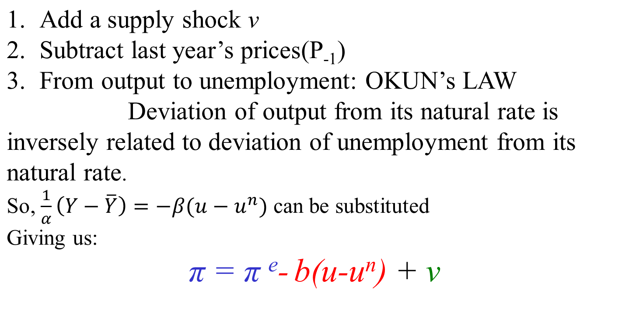
Y = ¯Y + α (P - P^{e}), α > 0

Slide 9
Are There Two Phillips Curves?
Economists began to question the Phillips curve in the 1970s and early 80s.
Focusing on the period of 1970 – 1996, we notice that stagflation is possible.
The Existence of stagflation implies that a tradeoff between inflation and unemployment may not always exist.

Slide 10
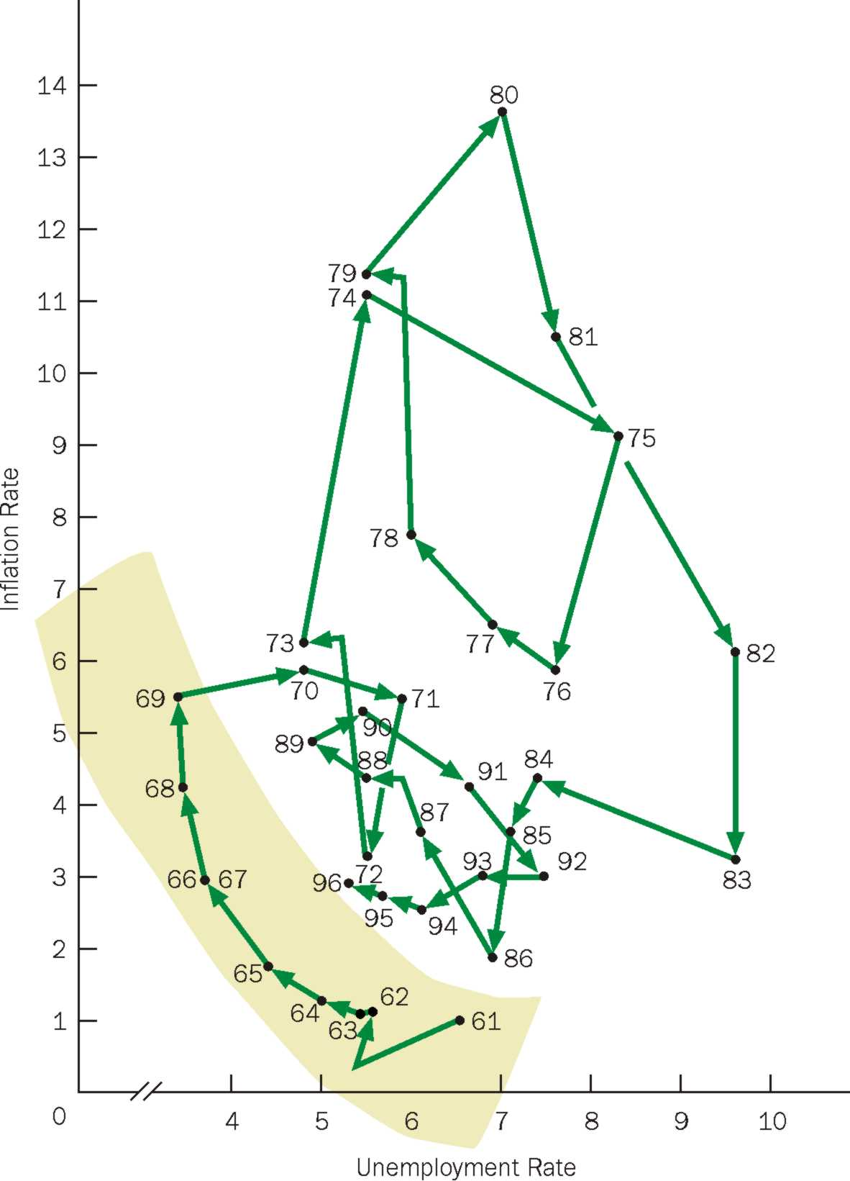
The Diagram That Raises Questions: Inflation and Unemployment 1961-1996

Slide 11
Friedman and the Natural Rate Theory
There are Two not One Phillips Curves.
There is a Short Run Phillips Curve, and a Long Run Phillips Curve.
There is a tradeoff between inflation and unemployment in the Short Run, but not in the Long Run.

Slide 12
Friedman’s Natural Rate Theory
The short-run Phillips curve exhibits a tradeoff between inflation and unemployment, while the long-run Phillips curve does not.
This is the Friedman Natural Rate Theory: in the long run, the economy returns to its natural rate of unemployment and the only reason it moved away from the natural unemployment rate in the first place was because workers were “fooled” (in the short run) into thinking inflation was lower than it really was.

Slide 13
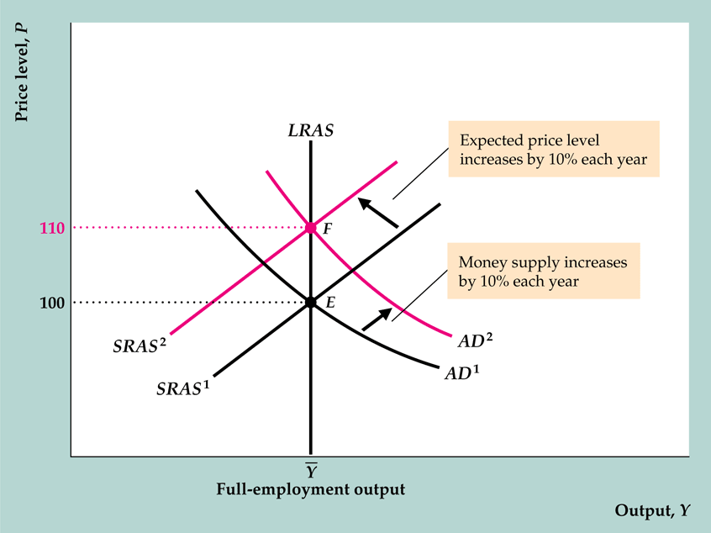
Ongoing inflation in the extended classical model

Slide 14

How Do People Form Expectations
Individuals form their expected inflation rate by looking at past inflation rates.
A person who forms an opinion this way is said to hold adaptive expectations.

Slide 15
Rational Expectations
Rational expectations holds that individuals form the expected inflation rate not only on the basis of their past experience with inflation, but also on their predictions about effects of present and future policy actions and events.
The expected inflation rate is formed by looking at the past, present, and future.

Slide 16

Do People Anticipate Policy?
Not all persons need to anticipate policy. As long as some do, the consequences may be the same as if all persons do.

Slide 17
The Phillips Curve Equation
Natural
rate of unemp.
Unemp. rate
–
a
Actual inflation
–
Expected inflation
=
When expected inflation goes up,
(Actual inflation – Expected inflation) gets less positive or even negative
Unemployment rate goes up

Slide 18
How Expected Inflation Shifts the PC
Initially, expected &
actual inflation = 3%,
unemployment =
natural rate (6%).
RBI makes inflation 2% higher than expected,
u-rate falls to 4%.
In the long run,
expected inflation increases to 5%,
PC shifts upward,
unemployment returns to its natural rate.
inflation
LRPC
B
C
5%
3%
A
PC₂
PC₁
4%
6%
u-rate

Slide 19
2 Causes of Inflation
The second term, β(u-u^{n}), shows that cyclical unemployment exerts downward pressure on inflation. Low unemployment pulls the inflation rate up. This is called demand-pull inflation.
An adverse supply shock, such as the rise in world oil prices in the 70s, implies a positive value of n and causes inflation to rise. This is called cost-push inflation because adverse supply shocks are typically events that push up the costs of production.

Slide 20
The sacrifice ratio –the cost of reducing inflation
When unanticipated tight monetary and fiscal policies are used to reduce inflation, they reduce output and employment for a time, a cost that must be weighed against the benefits of lower inflation
Economists use the sacrifice ratio as a measure of the costs
Sacrifice ratio is the number of percentage points of output lost in reducing inflation by one percentage point
    Ball’s study: U.S. inflation fell by 8.83 % in the early 1980s, with a loss in output of 16.18% of the nation’s potential output
    Sacrifice ratio = 16.18/8.83 = 1.832

Slide 21
The sacrifice ratio
Ball studied the sacrifice ratios for many different disinflations around the world in the 1960s, 1970s, and 1980s
    The sacrifice ratios varied substantially across countries, from less than 1 to almost 3
    One factor affecting the sacrifice ratio is the flexibility of the labor market
      Countries with slow wage adjustment have higher sacrifice ratios
  Ball’s results should be interpreted with caution, since it isn’t easy to calculate the loss of output and because supply shocks can distort the calculation of the sacrifice ratio

